Slide 1
Module 4 Push Down Automata (PDA)

Slide 2
Hierarchy of Languages
Recursively Enumerable Language
(Language for Turing Machine)
Context Sensitive Language
(Language for Low Bound Automata)
Context Free Language
(Language for Push Down Automata)
Regular Language
(Language for Finite Automata)

Slide 3
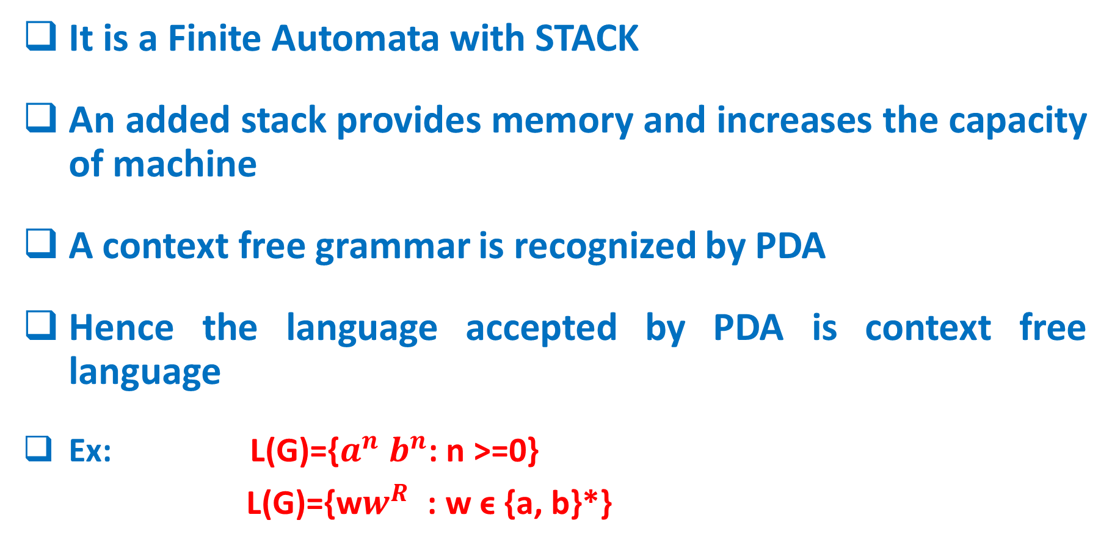
Push Down Automata(PDA)
It is a Finite Automata with STACK
An added stack provides memory and increases the capacity of machine
A context free grammar is recognized by PDA
Hence the language accepted by PDA is context free language
Ex: L(G)={$a^{n}$ $b^{n}$: n >=0}
L(G)={w$w^{R}$ : w ϵ {a, b}*}

Slide 4


PDA Block Diagram
Read input symbol
Perform Stack Operations
-PUSH()
-POP()
-Empty()
-Read TOP
3) Make changes in states
4) Procedure is repeated until string is scanned completely
Input Symbol reading
Top of the stack
Control Unit
STACK

Slide 5
STACK Operations
There are THREE stack operations
POP() Operation
deletes topmost element in Stack
2) PUSH() Operation
inserts element at top in Stack
3) NOP() Operation
No deletion, no insertion at top
TOP
TOP
TOP
TOP
TOP
TOP
a
b
a
z0
a
b
a
z0
a
b
a
z0
a
b
a
az0
b
a
z0
b
a
z0
Before POP() operation
After POP() Operation
Before PUSH() operation
After PUSH() Operation
Before NOP() operation
After NOP() Operation

Slide 6
Transition Function in PDA
Transition Function in PDA depends upon
Current State (Qi)
Current input (a)
TOP of stack (b)
Input String :
ba
Qi
I/P symbol,
Stack TOP
/Stack Content
Qj
TOP
TOP
a
b
Z0
Qi
Qj
b
Z0
a,
b/
ab
Stack before PUSH(a)
Stack after PUSH(a)
Transition Diagram for PUSH(a)

Slide 7
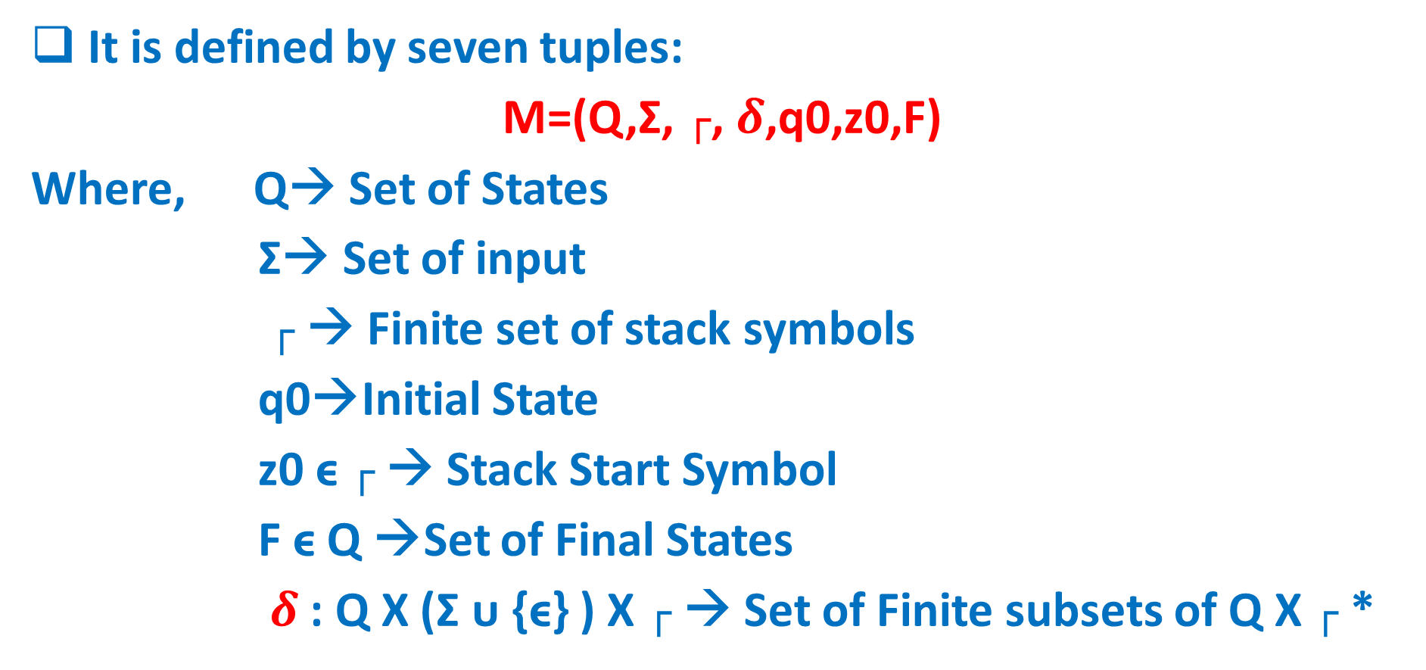
Non-deterministic PDA Definition
It is defined by seven tuples:
M=(Q,Σ, ┌, $δ$,q0,z0,F)
Where, Q→ Set of States
Σ→ Set of input
┌ → Finite set of stack symbols
q0→Initial State
z0 ϵ ┌ → Stack Start Symbol
F ϵ Q →Set of Final States
$δ$: Q X (Σ ᴜ {ϵ} ) X ┌ → Set of Finite subsets of Q X ┌ *

Slide 8
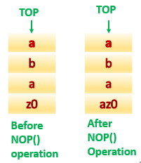
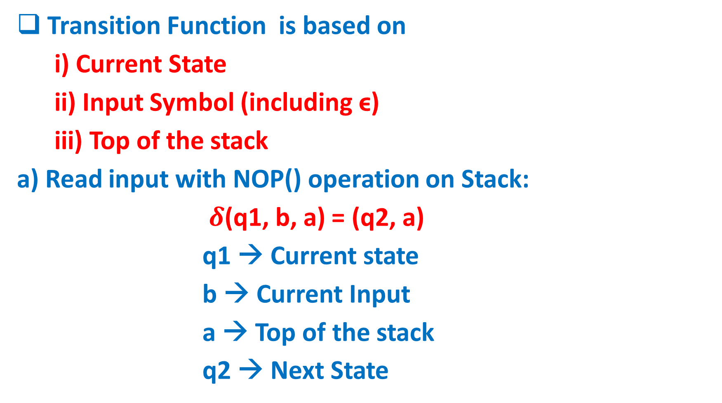
Transition Function in NPDA
Transition Function is based on
i) Current State
ii) Input Symbol (including ϵ)
iii) Top of the stack
a) Read input with NOP() operation on Stack:
$δ$(q1, b, a) = (q2, a)
q1 → Current state
b → Current Input
a → Top of the stack
q2 → Next State

Slide 9
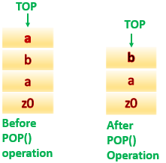
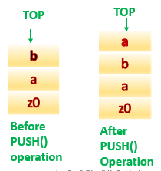
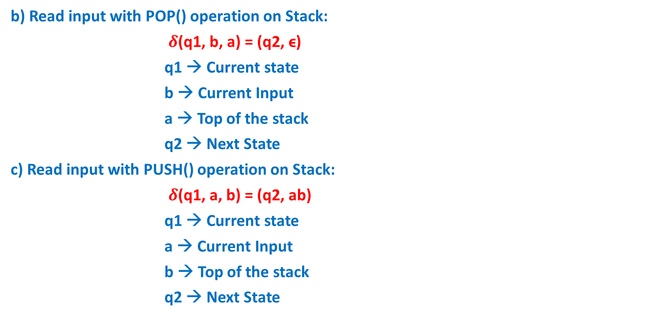
Transition Function in NPDA continue..
b) Read input with POP() operation on Stack:
$δ$(q1, b, a) = (q2, ϵ)
q1 → Current state
b → Current Input
a → Top of the stack
q2 → Next State
c) Read input with PUSH() operation on Stack:
$δ$(q1, a, b) = (q2, ab)
q1 → Current state
a → Current Input
b → Top of the stack
q2 → Next State

Slide 10
NPDA Example 1
1) Obtain NPDA to accept language L(G)={$a^{n}$ $b^{n}$: n>=1, Σ={a, b}* }
Solution:
Accepting Strings={ab, aabb, aaabbb, aaaabbbb,……}
Rejecting Strings={a,b,aab,baa,abab,aabbb,……}
Let sample String is aabb
The number of times push(a) is equals to pop(a)
Hence count of ‘a’ is equals to count of ‘b’
TOP
TOP
TOP
a
a
Z0
TOP
TOP
a
Z0
a
Z0
Z0
Z0
Initially Stack is empty()
push(a)
push(a)
pop(a)
pop(a)

Slide 11
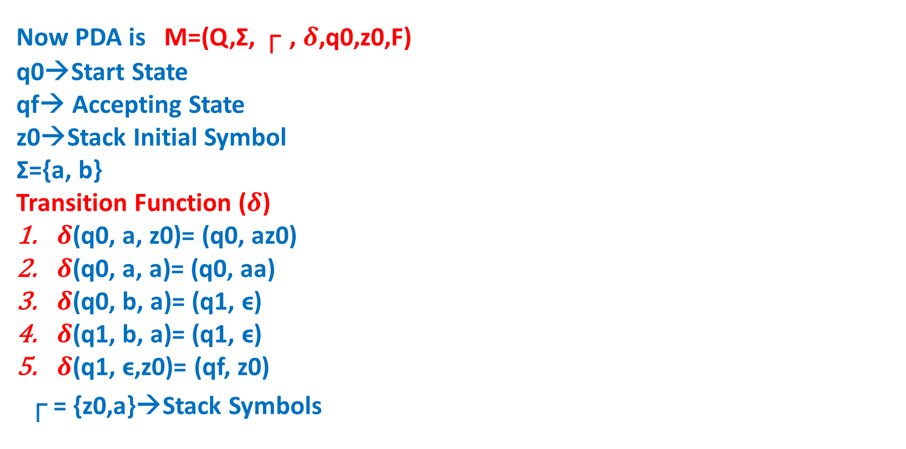
NPDA Example 1 continue..
Now PDA is M=(Q,Σ, ┌ , $δ$,q0,z0,F)
q0→Start State
qf→ Accepting State
z0→Stack Initial Symbol
Σ={a, b}
Transition Function ($δ$)
$δ$(q0, a, z0)= (q0, az0)
$δ$(q0, a, a)= (q0, aa)
$δ$(q0, b, a)= (q1, ϵ)
$δ$(q1, b, a)= (q1, ϵ)
$δ$(q1, ϵ,z0)= (qf, z0)
┌ = {z0,a}→Stack Symbols
a, z0/az0
a, a/aa
b, a/ϵ
q0
b, a/ϵ
q1
ϵ, z0/z0
qf
Transition Diagram

Slide 12
NPDA Example 1 continue..
Sample Accepting String : aabb
(q0, aabb, z0)
|-- (q0, abb,az0) -----push(a)
|--(q0, bb, aaz0) -----push(a)
|--(q1, b, az0) -----pop(a)
|--(q1, ϵ,z0) -----pop(a)
|--(qf, z0)
Reached Final State with empty stack
Therefore, aabb is accepted
Sample Rejecting String : abab
(q0, abab, z0)
|-- (q0, bab,az0) ----push(a)
|-- (q1, ab, z0) ----pop(a)
String is not processed completely but stack is empty.
Therefore, abab is rejected

Slide 13
NPDA Example 2
2) Obtain NPDA to accept language L(G)={w|w ϵ {a, b}* & $n_{a}\left(w\right)=n_{b}\left(w\right)$}
Solution:
Accepting Strings={ab , aabb , abab , baba , bbaa , ……}
Rejecting Strings={a, b , aba , bab ,aab , baa , aabbb,……}
Let sample String is baba
Scan first symbol & push() into stack, scan next symbol, if it is not equal to first symbol, pop() first symbol from stack
TOP
TOP
TOP
TOP
b
Z0
TOP
Z0
b
Z0
Initially Stack is empty()
Z0
Z0
push(b)
pop(b)
push(b)
pop(b)

Slide 14
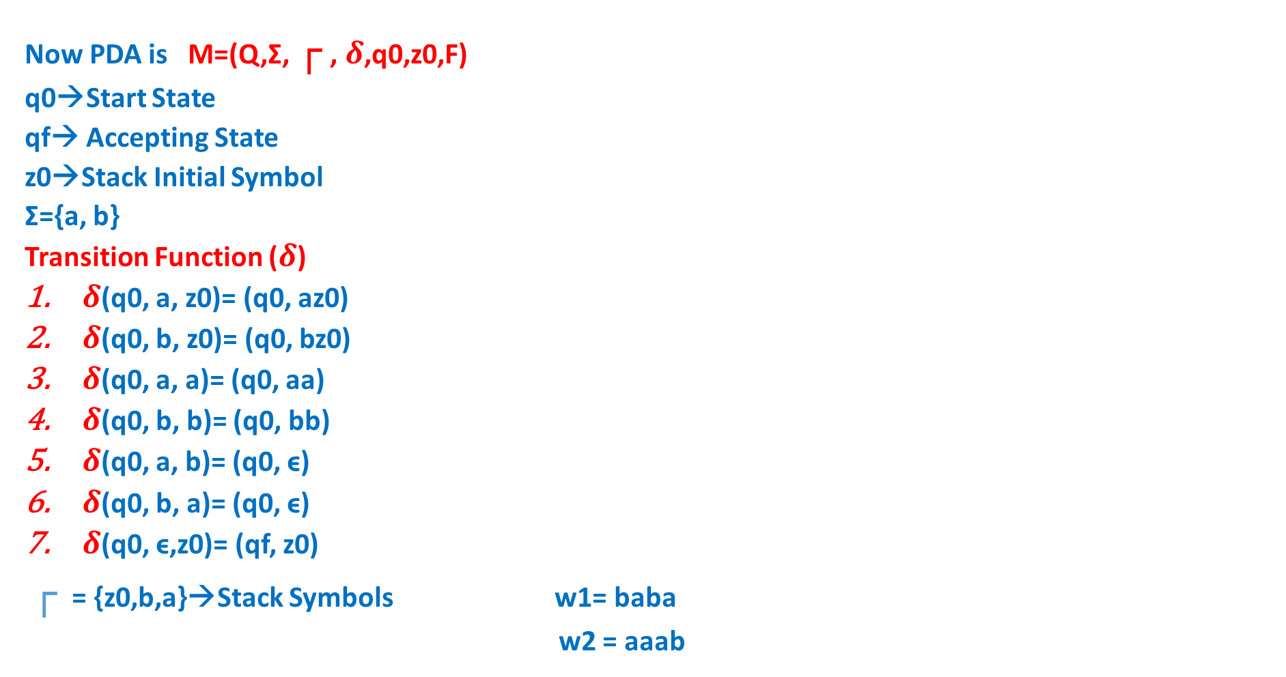
NPDA Example 2 continue..
Now PDA is M=(Q,Σ, ┌ , $δ$,q0,z0,F)
q0→Start State
qf→ Accepting State
z0→Stack Initial Symbol
Σ={a, b}
Transition Function ($δ$)
$δ$(q0, a, z0)= (q0, az0)
$δ$(q0, b, z0)= (q0, bz0)
$δ$(q0, a, a)= (q0, aa)
$δ$(q0, b, b)= (q0, bb)
$δ$(q0, a, b)= (q0, ϵ)
$δ$(q0, b, a)= (q0, ϵ)
$δ$(q0, ϵ,z0)= (qf, z0)
┌ = {z0,b,a}→Stack Symbols w1= baba
w2 = aaab
a, z0/az0
b, z0/bz0
a, a/aa
b, b/bb
a, b/ϵ
b, a/ϵ
q0
ϵ, z0/z0
qf
Transition Diagram

Slide 15
NPDA Example 2 continue..
Sample Accepting String : baba
(q0, baba, z0)
|- (q0, aba,bz0) ----push(b)
|- (q0, ba, z0) ----pop(b)
|- (q0, a, bz0) ----push(b)
|- (q0, ϵ,z0) ----pop(b)
|- (qf, z0)
Reached Final State with empty stack
Therefore, baba is accepted
Sample Rejecting String : aaab
(q0, aaab, z0)
|- (q0, aab,az0) ----push(a)
|- (q0, ab, aaz0) ----push(a)
|- (q0, b, aaaz0) ----push(a)
|- (q0, ϵ, aaz0) ----pop(a)
Reached end of string without empty stack
Therefore, aaab is rejected

Slide 16
NPDA Example 3
3) Obtain NPDA to accept language L(G)={w$w^{R}$ : w ϵ {a, b}*}
Solution:
Accepting Strings={aa , bb , abba , baab , abbbba , abaaba , ……}
Rejecting Strings={a, b , aba , bab ,aab , baa , abab, aabbb,……}
Let sample String is baab
Scan first symbol & push() into stack, scan next symbol, push() into stack, repeat push() until u reach middle of string, after mid if scanning symbol is matching with top of stack, do pop()
TOP
TOP
TOP
TOP
a
b
Z0
b
Z0
TOP
Z0
b
Z0
Initially Stack is empty()
Z0
push(b)
push(a)
pop(a)
pop(b)

Slide 17
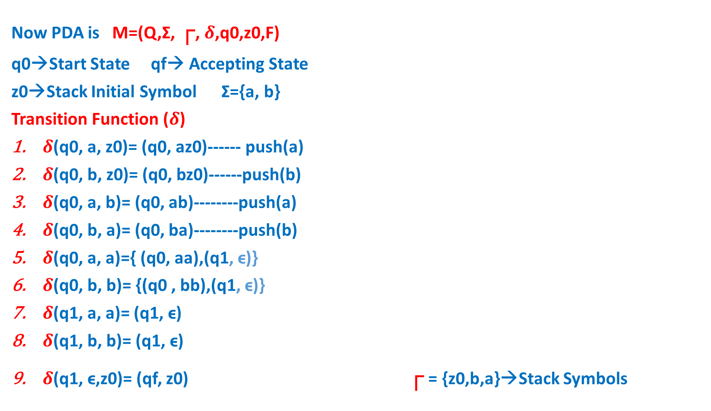
NPDA Example 3 continue..
Now PDA is M=(Q,Σ, ┌, $δ$,q0,z0,F)
q0→Start State qf→ Accepting State
z0→Stack Initial Symbol Σ={a, b}
Transition Function ($δ$)
$δ$(q0, a, z0)= (q0, az0)------ push(a)
$δ$(q0, b, z0)= (q0, bz0)------push(b)
$δ$(q0, a, b)= (q0, ab)--------push(a)
$δ$(q0, b, a)= (q0, ba)--------push(b)
$δ$(q0, a, a)={ (q0, aa),(q1, ϵ)}
$δ$(q0, b, b)= {(q0 , bb),(q1, ϵ)}
$δ$(q1, a, a)= (q1, ϵ)
$δ$(q1, b, b)= (q1, ϵ)
$δ$(q1, ϵ,z0)= (qf, z0) ┌ = {z0,b,a}→Stack Symbols
a, z0/az0
b, z0/bz0
a, a/aa
b, b/bb
a, b/ab
b, a/ba
a, a/ϵ
b, b/ϵ
q0
q1
ϵ, z0/z0
qf
a, a/ϵ
b, b/ϵ
Transition Diagram

Slide 18
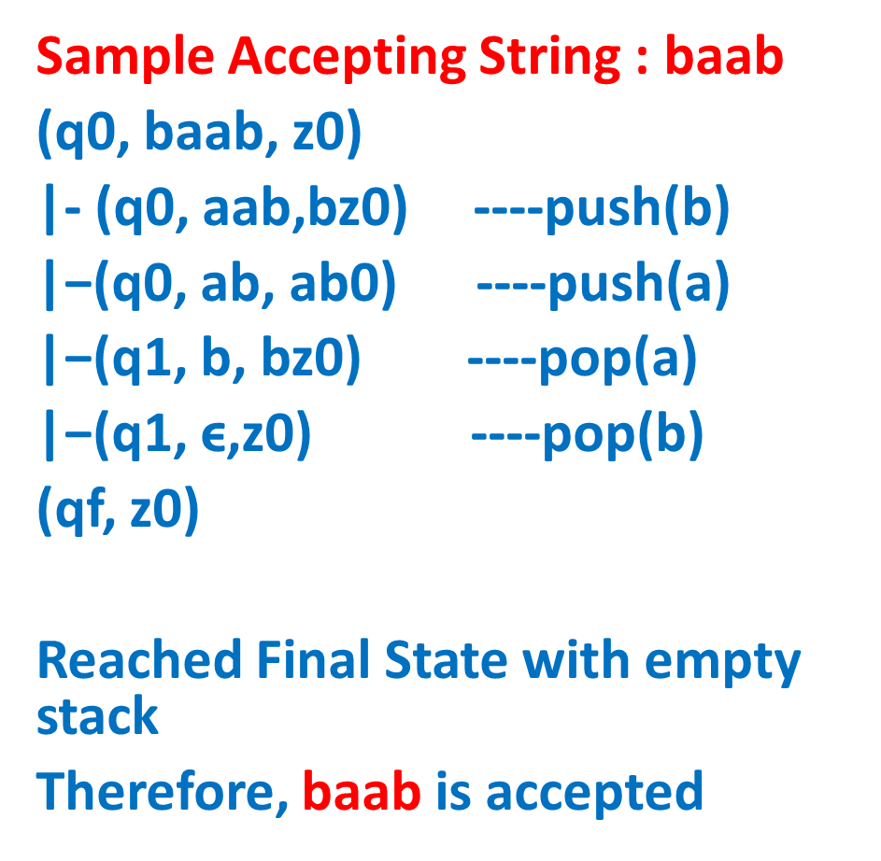
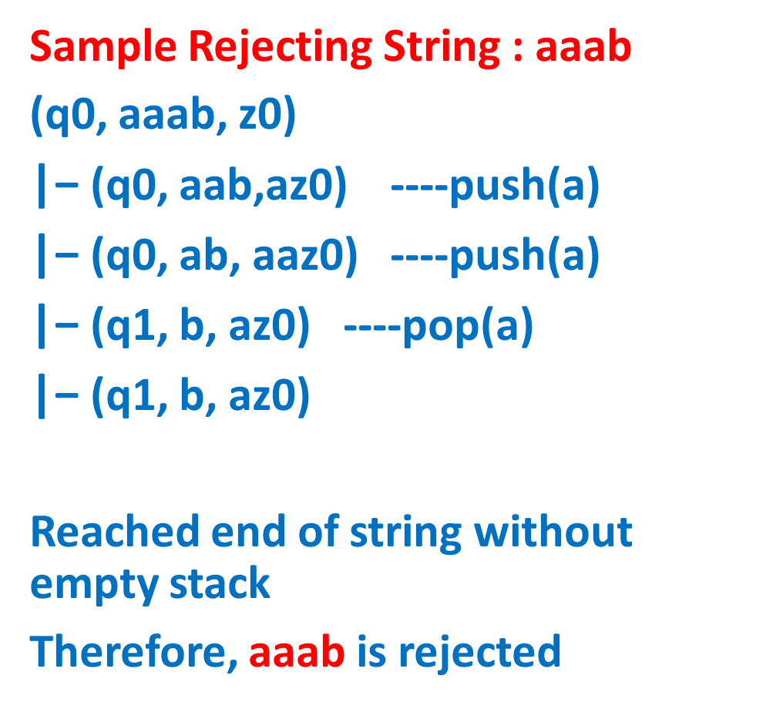
NPDA Example 3 continue..
Sample Accepting String : baab
(q0, baab, z0)
|- (q0, aab,bz0) ----push(b)
$\text{|−}$(q0, ab, ab0) ----push(a)
$\text{|−}$(q1, b, bz0) ----pop(a)
$\text{|−}$(q1, ϵ,z0) ----pop(b)
(qf, z0)
Reached Final State with empty stack
Therefore, baab is accepted
Sample Rejecting String : aaab
(q0, aaab, z0)
$\text{|−}$ (q0, aab,az0) ----push(a)
$\text{|−}$ (q0, ab, aaz0) ----push(a)
$\text{|−}$ (q1, b, az0) ----pop(a)
$\text{|−}$ (q1, b, az0)
Reached end of string without empty stack
Therefore, aaab is rejected

Slide 19
NPDA Example 4
4) Obtain NPDA to accept language L(G)={$a^{n}$ $b^{m}a^{n}$: n, m>=1}
Solution: consider n=2 & m=1
Accepting Strings={aba , abba , aabbaa , aabaa , abbba , ……}
Rejecting Strings={a, b , bab ,aab , baa , abab, aabbb,……}
Let sample String is aabaa
First push(a) all a’s.
When scaning symbol is b, do nop().
After nop(), if next symbol is a, check top of stack matching with a, then pop()
TOP
TOP
TOP
TOP
TOP
a
a
Z0
a
a
Z0
a
Z0
TOP
Z0
a
Z0
Z0
Initially Stack is empty()
push(a)
push(a)
nop()
pop(a)
pop(a)

Slide 20

NPDA Example 4 continue..
Now PDA is M=(Q,Σ,┌ , $δ$,q0,z0,F)
Σ={a, b}, ┌ = {z0,a}→Stack Symbols
Transition Function ($δ$)
$δ$(q0, a, z0)= (q0, az0) ----push(a)
$δ$(q0, a, a)= (q0, aa) ----push(a)
$δ$(q0, b, a)= (q1, a) ----nop()
$δ$(q1, b, a)= (q1, a) ----nop()
$δ$(q1, a, a)= (q2, ϵ) ----pop(a)
$δ$(q2, a, a)= (q2, ϵ) ----pop(a)
$δ$(q2, ϵ, z0)= (qf, z0)
a, z0/az0
a, a/aa
b, a/a
a, a/ϵ
ϵ, z0/z0
q0
q1
q2
qf
b, a/a
a, a/ϵ
Transition Diagram

Slide 21
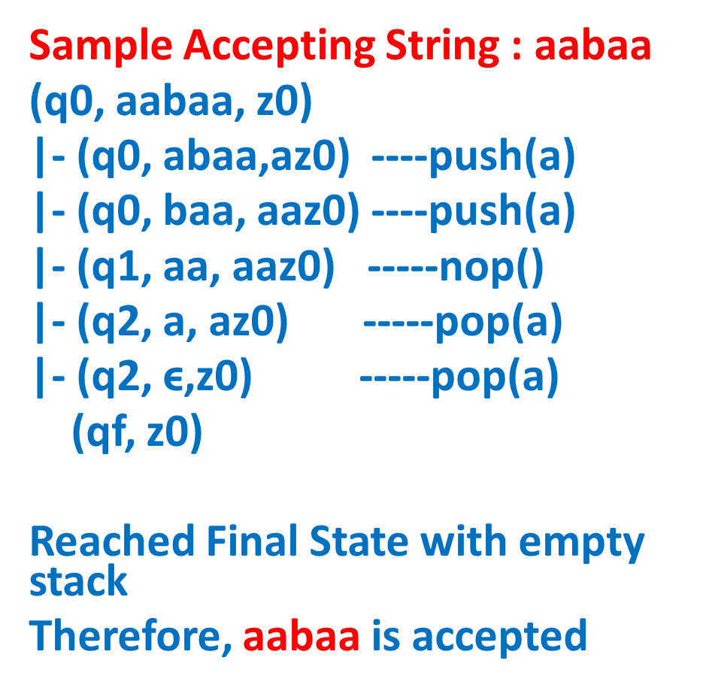
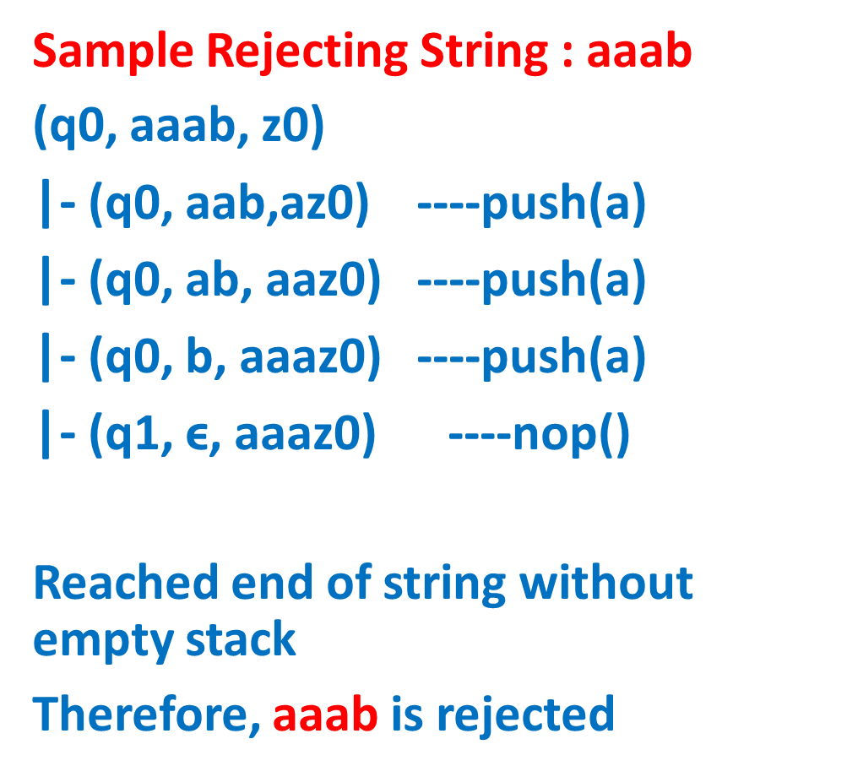
NPDA Example 4 continue..
Sample Accepting String : aabaa
(q0, aabaa, z0)
|- (q0, abaa,az0) ----push(a)
$\text{|−}$ (q0, baa, aaz0) ----push(a)
$\text{|−}$ (q1, aa, aaz0) -----nop()
$\text{|−}$ (q2, a, az0) -----pop(a)
$\text{|−}$ (q2, ϵ,z0) -----pop(a)
(qf, z0)
Reached Final State with empty stack
Therefore, aabaa is accepted
Sample Rejecting String : aaab
(q0, aaab, z0)
$\text{|−}$ (q0, aab,az0) ----push(a)
$\text{|−}$ (q0, ab, aaz0) ----push(a)
$\text{|−}$ (q0, b, aaaz0) ----push(a)
$\text{|−}$ (q1, ϵ, aaaz0) ----nop()
Reached end of string without empty stack
Therefore, aaab is rejected

Slide 22
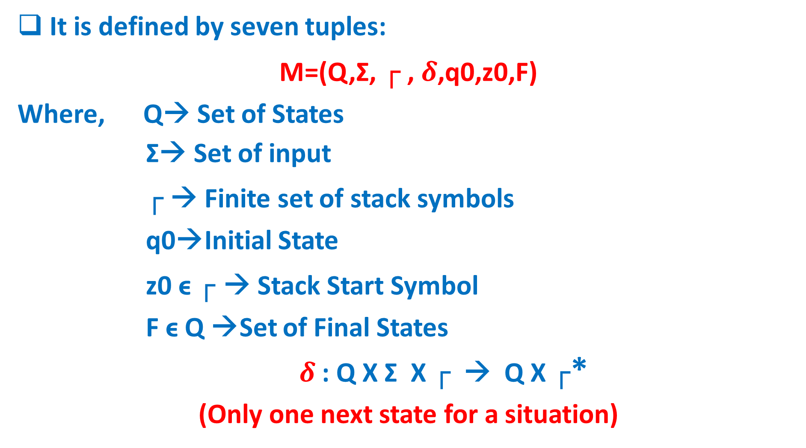
Deterministic PDA Definition
It is defined by seven tuples:
M=(Q,Σ, ┌ , $δ$,q0,z0,F)
Where, Q→ Set of States
Σ→ Set of input
┌ → Finite set of stack symbols
q0→Initial State
z0 ϵ ┌ → Stack Start Symbol
F ϵ Q →Set of Final States
$δ$: Q X Σ X ┌ → Q X ┌*
(Only one next state for a situation)

Slide 23
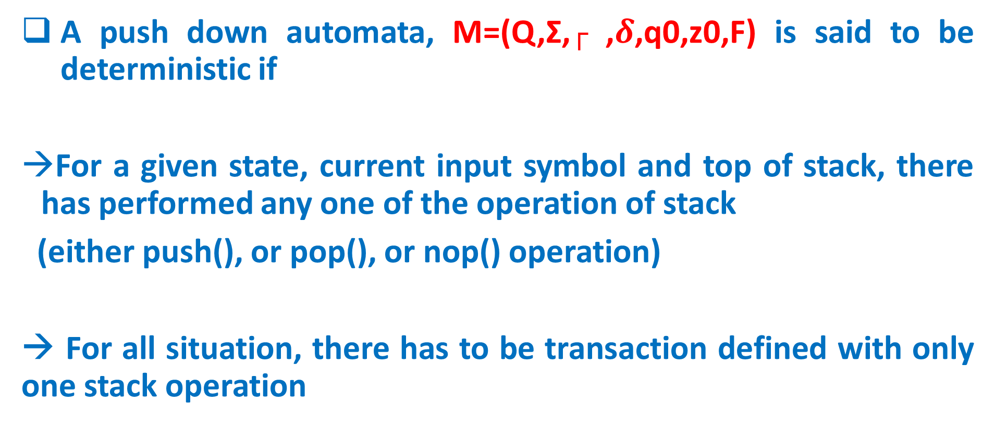
Deterministic PDA
A push down automata, M=(Q,Σ,┌ ,$δ$,q0,z0,F) is said to be deterministic if
For a given state, current input symbol and top of stack, there has performed any one of the operation of stack
(either push(), or pop(), or nop() operation)
→ For all situation, there has to be transaction defined with only one stack operation

Slide 24
DPDA Example 1
1) Obtain DPDA to accept language L(M)={w${cw}^{R}$ : w ϵ {a, b}+}
Solution:
Accepting Strings={aca, bcb, abcba, aabcbaa, abacaba, babcbab,….}
Rejecting Strings={a, b , bab ,aab , baa , abab, aabbb,……}
Let sample String is abcba
Push() all symbols into stack, until u reach symbol ‘c’, after ‘c’ if top of stack is matching with scanning symbol, do pop()
TOP
TOP
TOP
TOP
TOP
b
a
Z0
b
a
Z0
a
Z0
TOP
a
Z0
Z0
Z0
Initially Stack is empty()
push(a)
push(b)
nop()
pop(b)
pop(a)

Slide 25
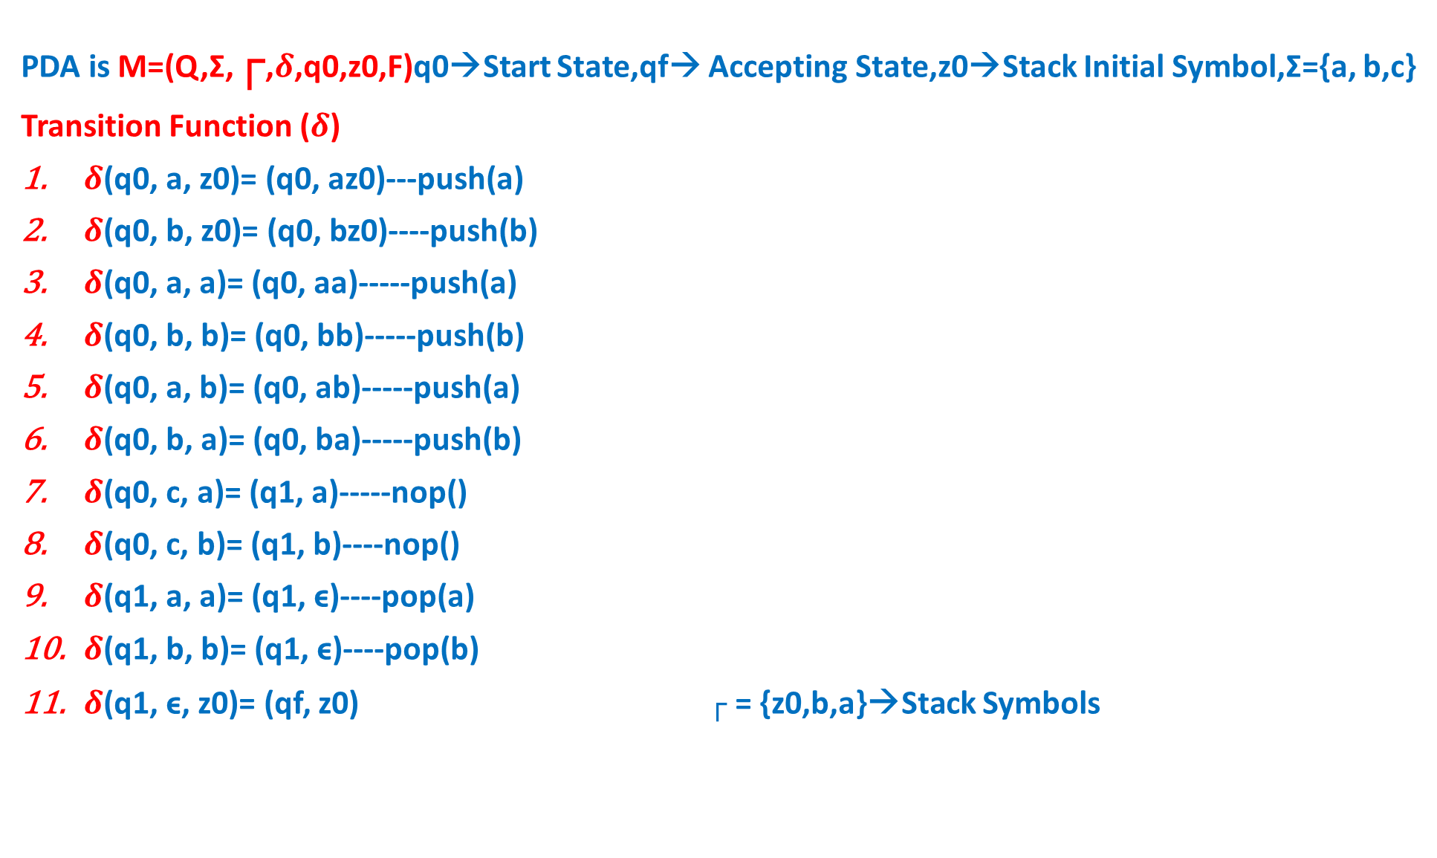
DPDA Example 1 continue..
PDA is M=(Q,Σ,┌,$δ$,q0,z0,F)q0→Start State,qf→ Accepting State,z0→Stack Initial Symbol,Σ={a, b,c}
Transition Function ($δ$)
$δ$(q0, a, z0)= (q0, az0)---push(a)
$δ$(q0, b, z0)= (q0, bz0)----push(b)
$δ$(q0, a, a)= (q0, aa)-----push(a)
$δ$(q0, b, b)= (q0, bb)-----push(b)
$δ$(q0, a, b)= (q0, ab)-----push(a)
$δ$(q0, b, a)= (q0, ba)-----push(b)
$δ$(q0, c, a)= (q1, a)-----nop()
$δ$(q0, c, b)= (q1, b)----nop()
$δ$(q1, a, a)= (q1, ϵ)----pop(a)
$δ$(q1, b, b)= (q1, ϵ)----pop(b)
$δ$(q1, ϵ, z0)= (qf, z0) ┌ = {z0,b,a}→Stack Symbols
a, z0/az0
b, z0/bz0
a, a/aa
b, b/bb
a, b/ab
a, b/ab
b, b/ϵ
a, a/ϵ
q0
c, a/a
c, b/b
q1
ϵ, z0/z0
qf
Transition Diagram

